Slide 1

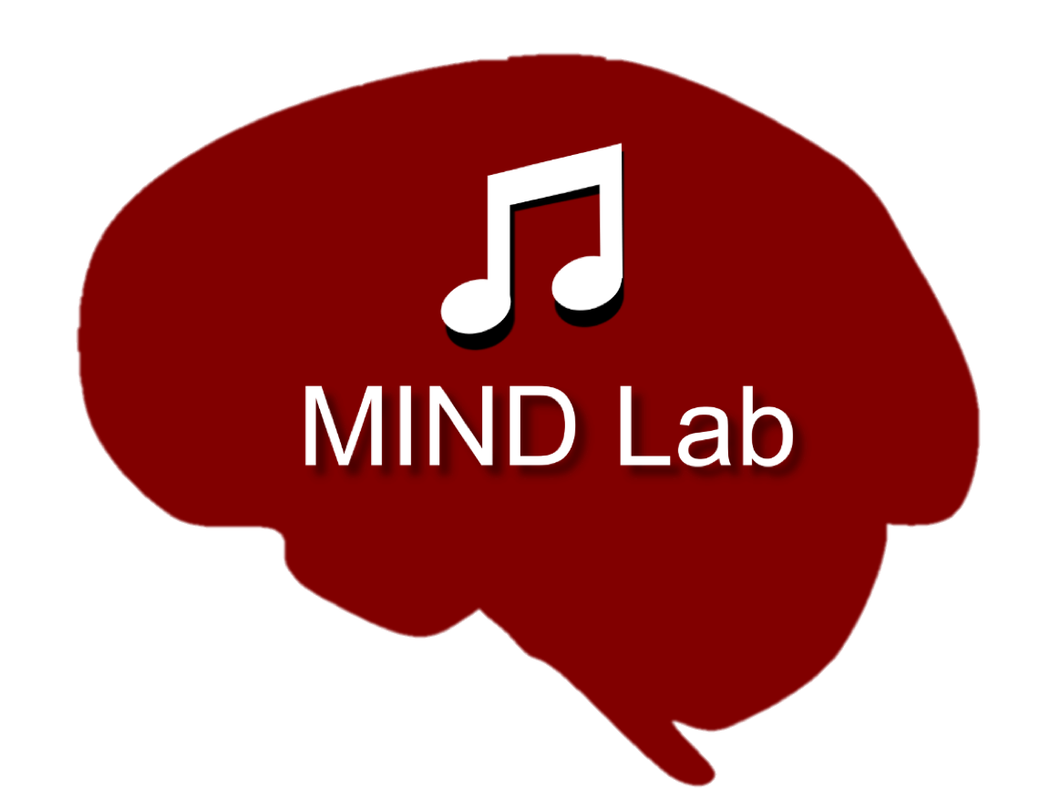
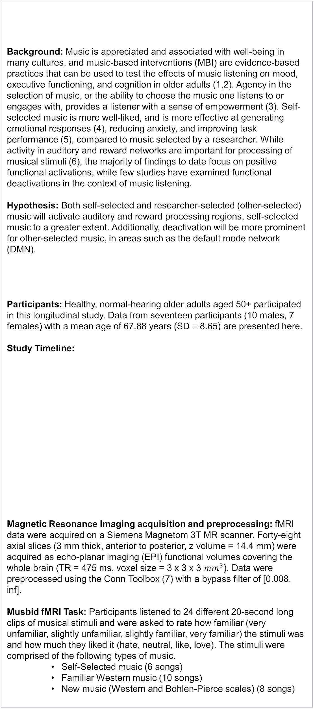
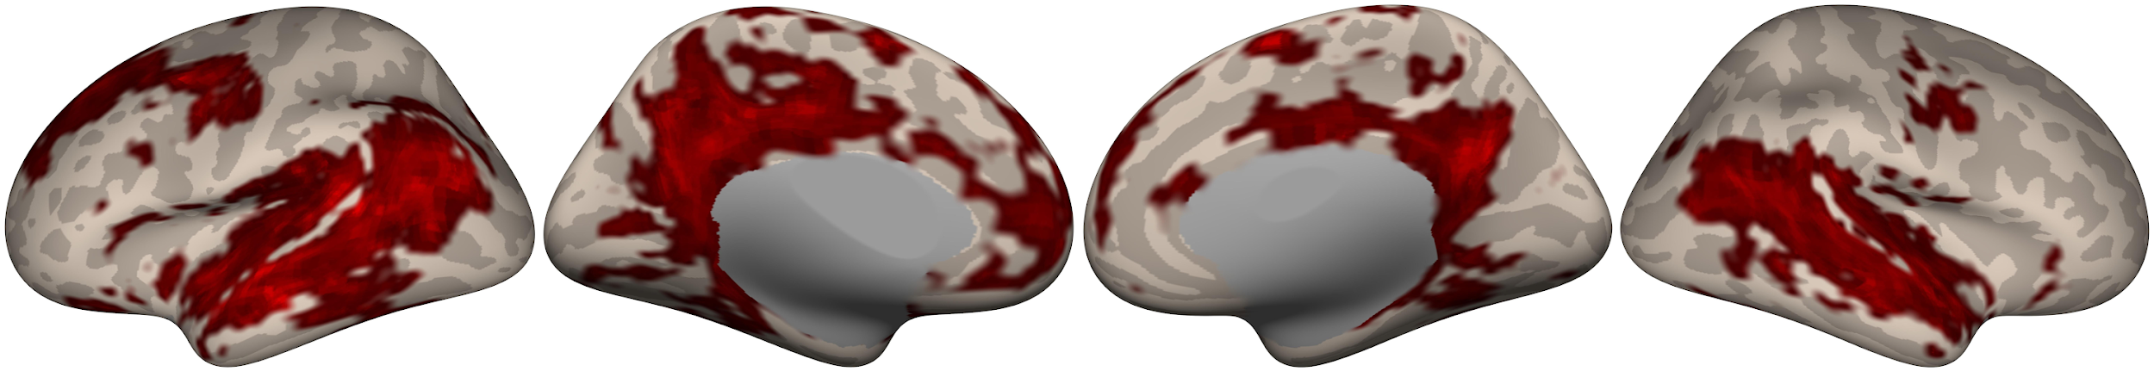
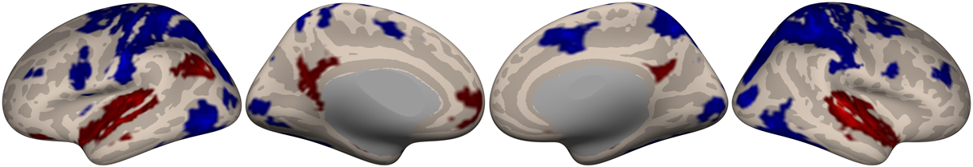
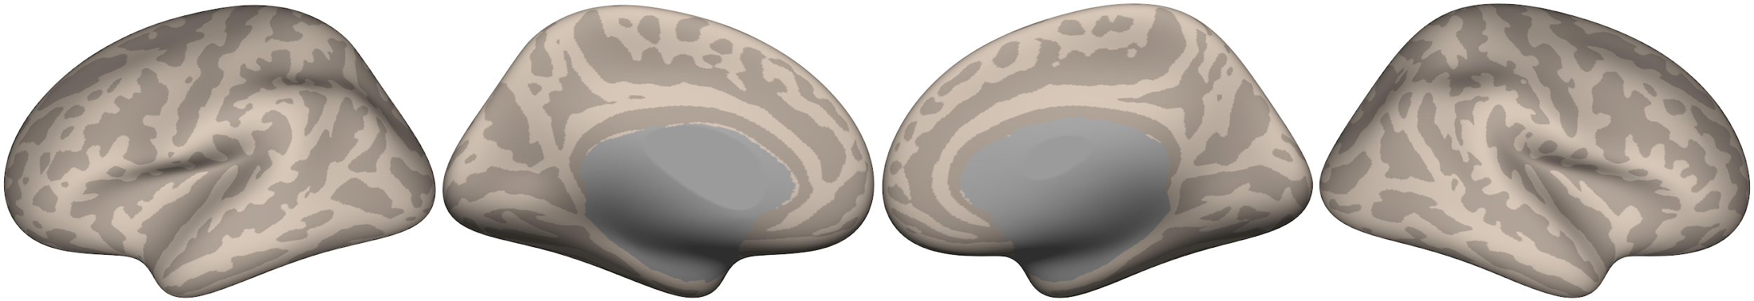
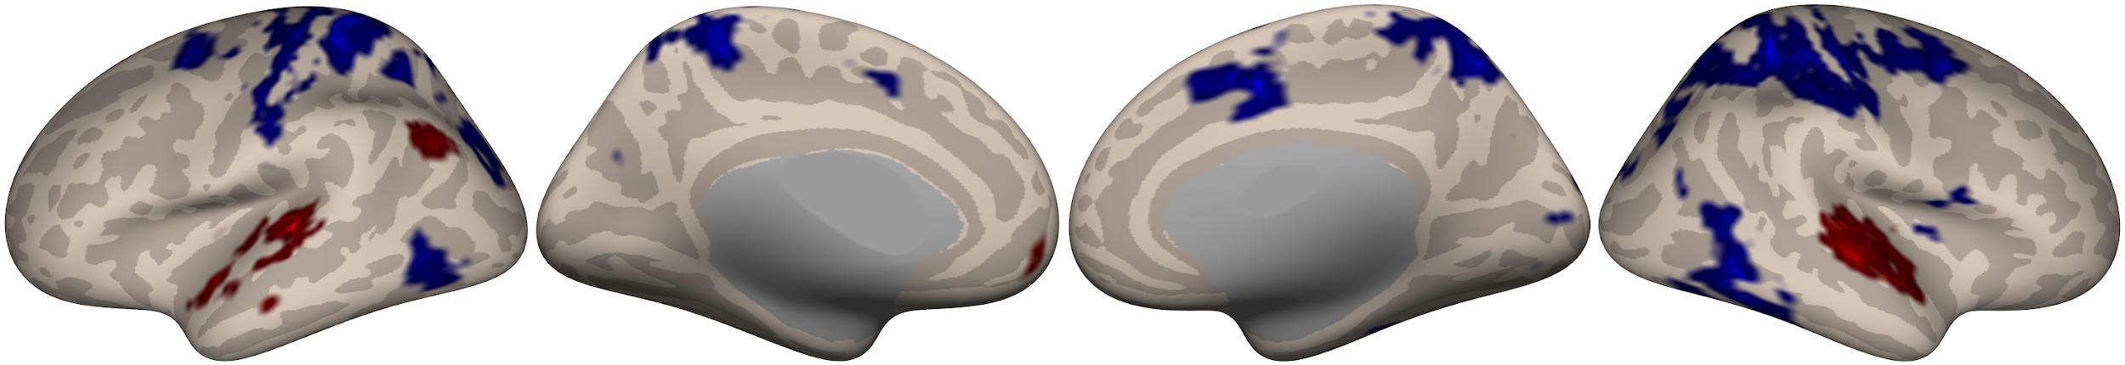
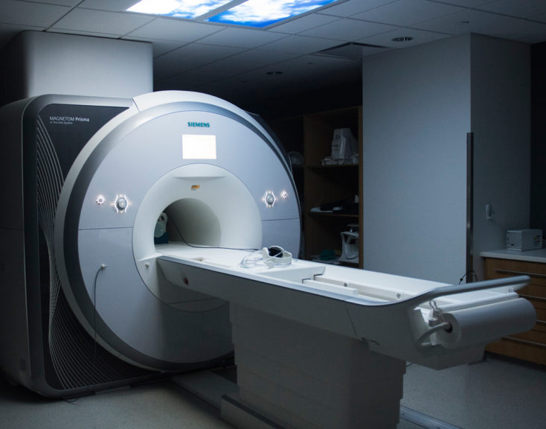
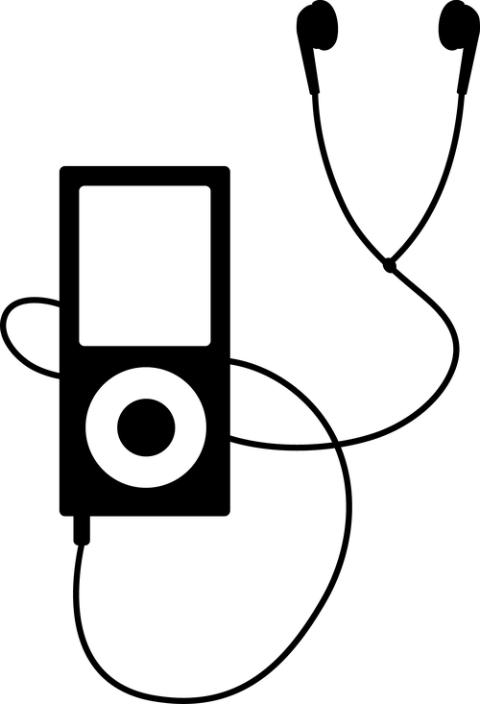
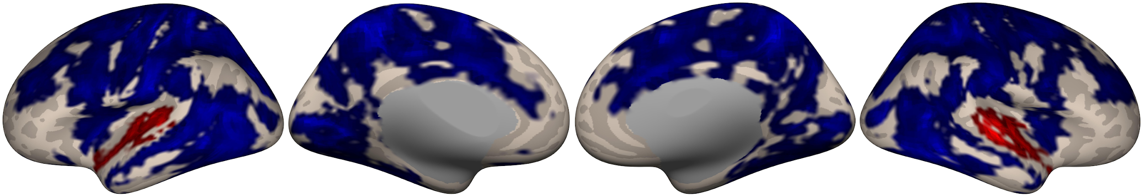
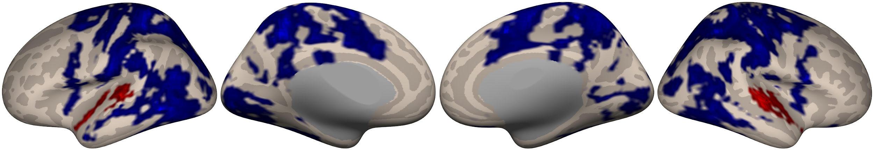
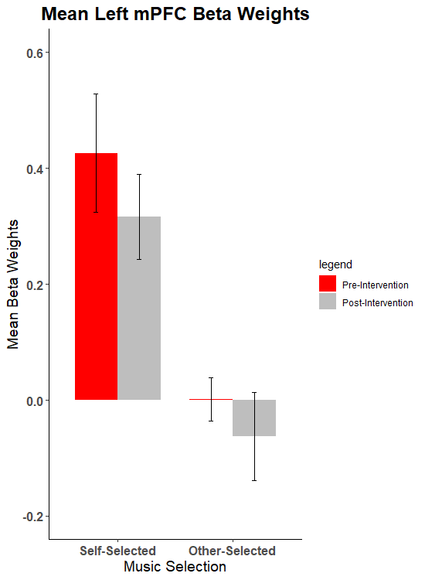
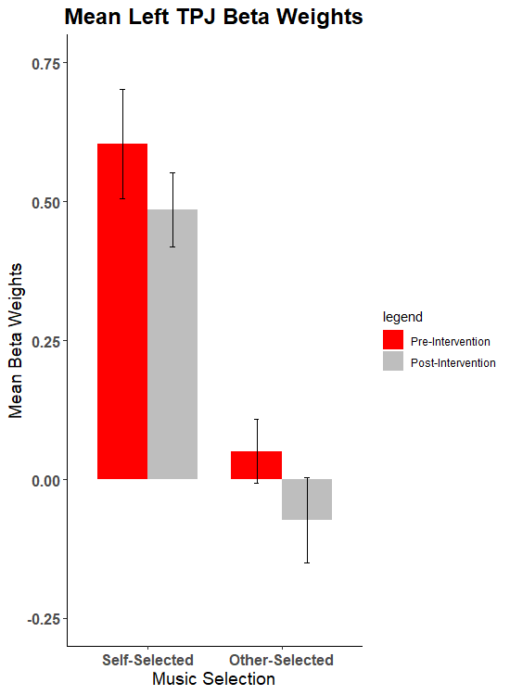
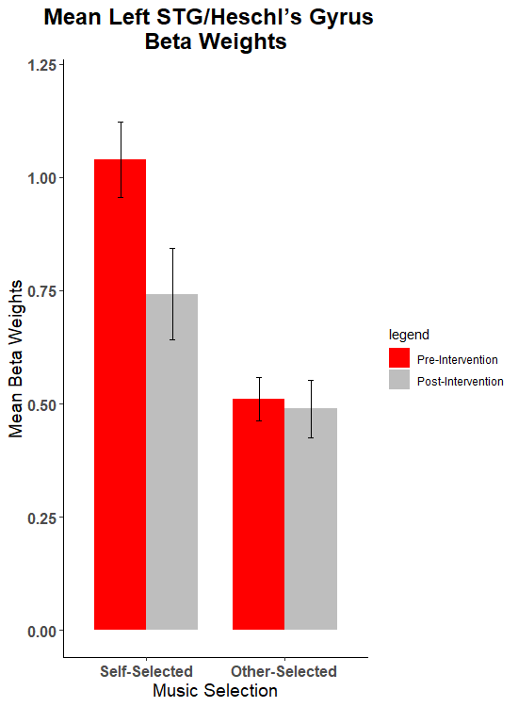
When You Heard it First: Age of Exposure Affects Functional Connectivity between mPFC and Auditory Network
Nicholas Kathios¹, Milena Aiello Quinci¹, Psyche Loui¹
¹Northeastern University
Introduction
Pre-intervention, listening to self-selected music elicited significant activation in the superior temporal gyrus (STG)/Heschl’s Gyrus, precuneus, cingulate, temporoparietal junction (TPJ), cingulate/medial prefrontal cortex (mPFC), and orbitofrontal cortex (OFC) and deactivation in the postcentral gyrus, supplementary motor area (SMA), frontal pole, precentral gyrus, middle frontal gyrus.
Post-intervention, listening to self-selected music elicited significant activation in the STG, TPJ, mPFC, and deactivation in the postcentral gyrus, inferior temporal gyrus, paracingulate gyrus, lateral occipital cortex, superior frontal gyrus, occipital pole, occipital fusiform gyrus, and cerebellum.
Both pre- and post-intervention, listening to other-selected music elicited significant activation in the STG, and deactivation in the OFC and a cluster spanning the precuneus, postcentral gyrus, precentral gyrus, lateral occipital cortex, TPJ, cingulate, middle frontal gyrus, cerebellum, superior parietal lobe, frontal lobe, and SMA.
Self-Selected > Other-Selected
Self-Selected Music
Self-selected music elicited greater activity than other-selected music in the precuneus, cingulate, TPJ, cerebellum, precentral gyrus, superior frontal gyrus, middle temporal gyrus, middle frontal gyrus, OFC, supramarginal gyrus, STG, Heschl’s gyrus. No significant clusters were observed at the post-intervention level.
Both self-selected and other-selected music elicited activity in auditory areas, specifically the STG, with greater activity for self-selected music.
Self-selected music elicited greater activity in reward regions and DMN regions, such as the mPFC and PCC, compared to other-selected music.
Other-selected music elicited widespread deactivation compared to self-selected music, resulting in a positive self-selected > other-selected contrast.
Greater engagement was observed pre-intervention compared to post-intervention for both self-selected and other-selected music.
Future Directions and Plans: Future plans for this project include 1) recruiting a larger sample of older adults and 2) incorporating a control intervention to test the impact of music relative to other interventions.
Innes, K. E., Selfe, T. K., Khalsa, D. S., & Kandati, S. (2016). Effects of meditation versus music listening on perceived stress, mood, sleep, and quality of life in adults with early memory loss: A pilot randomized controlled trial. J Alzheimers Dis, 52(4), 1277–1298. https://doi.org/10.1016/s0011-8486(07)80046-x
Domínguez-Chávez, C. J., Murrock, C. J., Guerrero, P. I. C., & Salazar-González, B. C. (2019). Music therapy intervention in community-dwelling older adults with mild cognitive impairment: A pilot study. Geriatric Nursing, 40, 614–619. https://doi.org/10.1016/j.gerinurse.2019.06.004
Ruud, E. (1997). Music and the quality of life. Nordic Journal of Music Therapy, 6(2), 86–97. https://doi.org/10.1080/08098139709477902
Liljeström, S., Juslin, P. N., & Västfjäll, D. (2013). Experimental evidence of the roles of music choice, social context, and listener personality in emotional reactions to music. Psychology of Music, 41(5), 579–599. https://doi.org/10.1177/0305735612440615
Cassidy, G., & MacDonald, R. (2009). The effects of music choice on task performance: A study of the impact of self-selected and experimenter-selected music on driving game performance and experience. Musicae Scientiae, 13(2), 357–386. https://doi.org/10.1177/102986490901300207
Belfi, A. M., & Loui, P. (2020). Musical anhedonia and rewards of music listening: Current advances and a proposed model. Annals of the New York Academy of Sciences, 1464(1), 99–114. https://doi.org/10.1111/nyas.14241
Whitfield-Gabrieli, S., & Nieto-Castanon, A. (2012). Conn: A functional connectivity toolbox for correlated and anticorrelated brain networks. Brain Connectivity, 2(3), 125–141. https://doi.org/10.1089/brain.2012.0073
Folstein, M. F., Folstein, S. E., & McHugh, P. R. (1975). “Mini-mental state”: A practical method for grading the cognitive state of patients for the clinician. Journal of psychiatric research, 12(3), 189-198.
Russell, D., Peplau, L. A., & Cutrona, C. E. (1980). The revised UCLA Loneliness Scale: concurrent and discriminant validity evidence. Journal of personality and social psychology, 39(3), 472.
Cohen S, Kamarck T, Mermelstein R. (1983). A Global Measure of Perceived Stress. Journal of Health and Social Behavior, 24(4), 385-96.
We acknowledge support from Grammy Foundation, NSF-CAREER 1945436, NSF-STTR 2014870, and Kim and Glenn Campbell Foundation.
Pre-Intervention (N=16)
Pre-Intervention (N=16)
Post-Intervention (N=11)
Post-Intervention (N=11)
Methods
Voxel Threshold: p FDR corrected <0.05; Cluster Threshold: p FDR corrected <0.05
Discussion
Voxel Threshold: p FDR corrected <0.05; Cluster Threshold: p FDR corrected <0.05
Other-Selected Music
Deactivation
Activation
Pre-intervention: MRI (T1, DTI, rsfMRI, task fMRI) and neuropsychological testing (including MMSE (8), Loneliness (9), PSS (10)
8-week music intervention: daily listening, reflection in a log book, and weekly check-ins with a music therapist
Post-intervention: MRI and neuropsychological testing, same as pre-intervention
Pre-Intervention (N=16)
Post-Intervention (N=11)
References
Voxel Threshold: p FDR corrected <0.05; Cluster Threshold: p FDR corrected <0.05
Effect of Self-Selection (ROI)
***
***
**
2-way rmANOVA, main effects
** p<0.01
*** p<0.001

